Slide 1
Beer Data Presentation - Resampling Task
Marcus Debnar – S2310454007 Stefan Habringer – S2310454013

Slide 2
Objective
Create additional data by sampling from the existing dataset
Skew resample to the left side of the distribution to simulate „bad“ additional data
Run Symbolic Regression and Clustering Algorithms on existing dataset, resample and combination

Slide 3
Data Preparation
41467_2024_46346_MOESM4_ESM.csv && 41467_2024_46346_MOESM7_ESM.csv
Merged Datasets – Overall Rating
Removed (>30) and Resampled (<=30) NaN‘s Column values
Created Data Set for Partition with Overall Rating as Category (Not enough, Sufficient, Satisfying, Good, Very good)

Slide 4
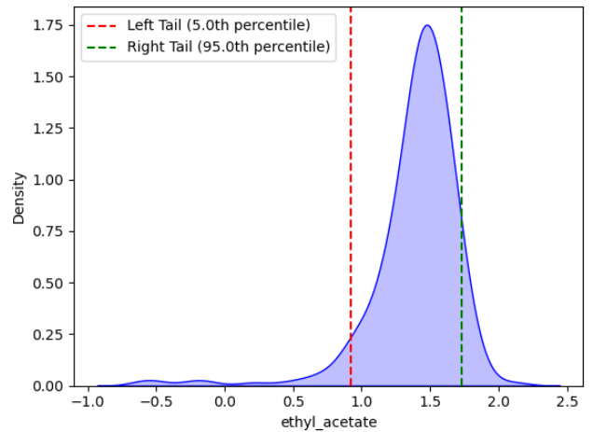
Resampling
Sample from left side distribution
Selected parameters:
Important parameters from the paper (ethyl_acetate,ethanol, ethyl_octanoate, ethyl.phenylacetate, protein, lactic_acid)
Correlataion induced (ethyl_acetate, kcalperc, isobutyl_acetate, H2S)

Slide 5
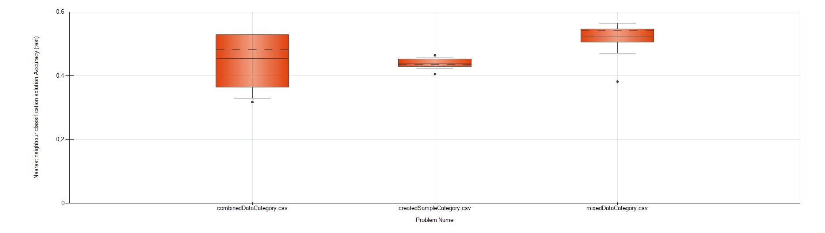
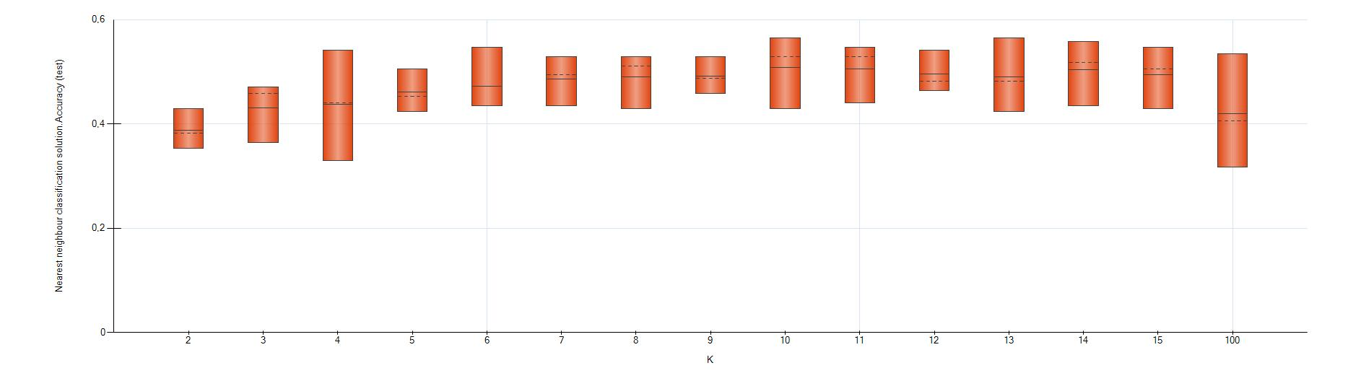
RESULTS CLUSTERING
TODO

Slide 6
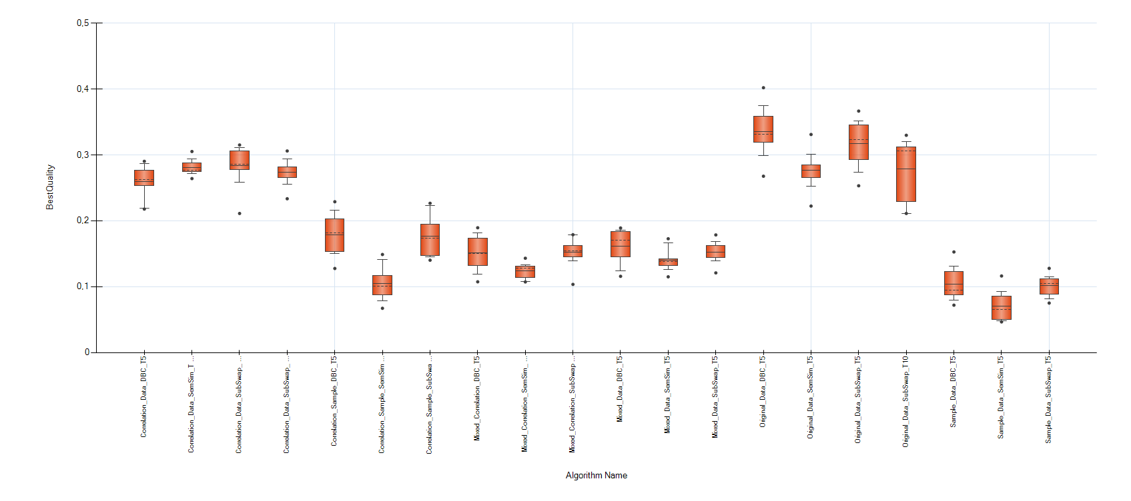
Symbolic Regression Task
Different Selectors and Crossovers for – original data – sample data – mixed data
Best results – original data with Deterministic Best Crossover – Tournament Selector Size 5

Slide 7
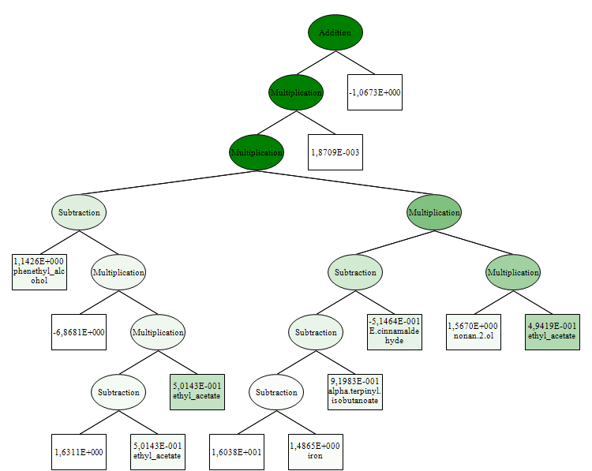
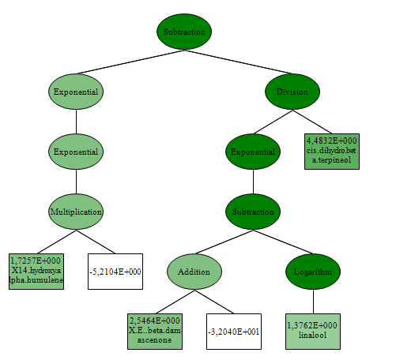
Symbolic Regression Task - Insights
Original Data
Sample Data
Model Depth: 10 | Length: 27
R2 Test: 0,03 | R2 Training: 0,33
Model Depth: 8 | Length: 17
R2 Test: 0,01 | R2 Training: 0,08

Slide 8
Lessons Learned
Resampling alogorithm needs finetuning
Additional information from sampling data lead to diverging results – quality rather low
Model results low – overfitting symbolic regression

